Slide 1
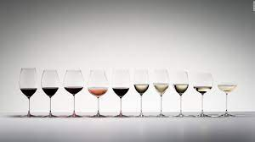
WINE QUALITY PREDICTION
WINE QUALITY PREDICTION
TEAM APEX
TEAM APEX

Slide 2
BUSINESS OBJECTIVE
The quality of a wine is important for the consumers as well as the wine industry. The traditional (expert) way of measuring wine quality is time-consuming. Nowadays, machine learning models are important tools to replace human tasks. In this case, there are several features to predict the wine quality but the entire features will not be relevant for better prediction. So, our thesis work is focusing on what wine features are important to get the promising result. For the purpose of classification model and evaluation of the relevant features, we used various classification models to predict the accuracies. To evaluate the feature importance we used the correlation and performance measurement matrices such as accuracy, recall, precision, and f1 score for comparison of the machine learning algorithm. A grid search algorithm was applied to improve the model accuracy.

Slide 3
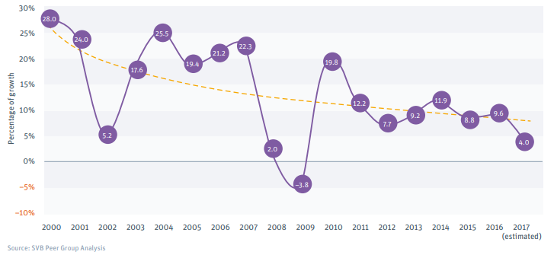
PROBLEM STATEMENT:
It helps the wines industries mitigate their costs that incur in manual wine testing.
Buying the best quality wine just based on the ingredients with the accuracies performed using classification models and support wine industries in deciding the price of the wine bottle which in turn in increase of sales and revenue.
There is possibility of fraud on selling a low Quality wine for higher price.

Slide 4
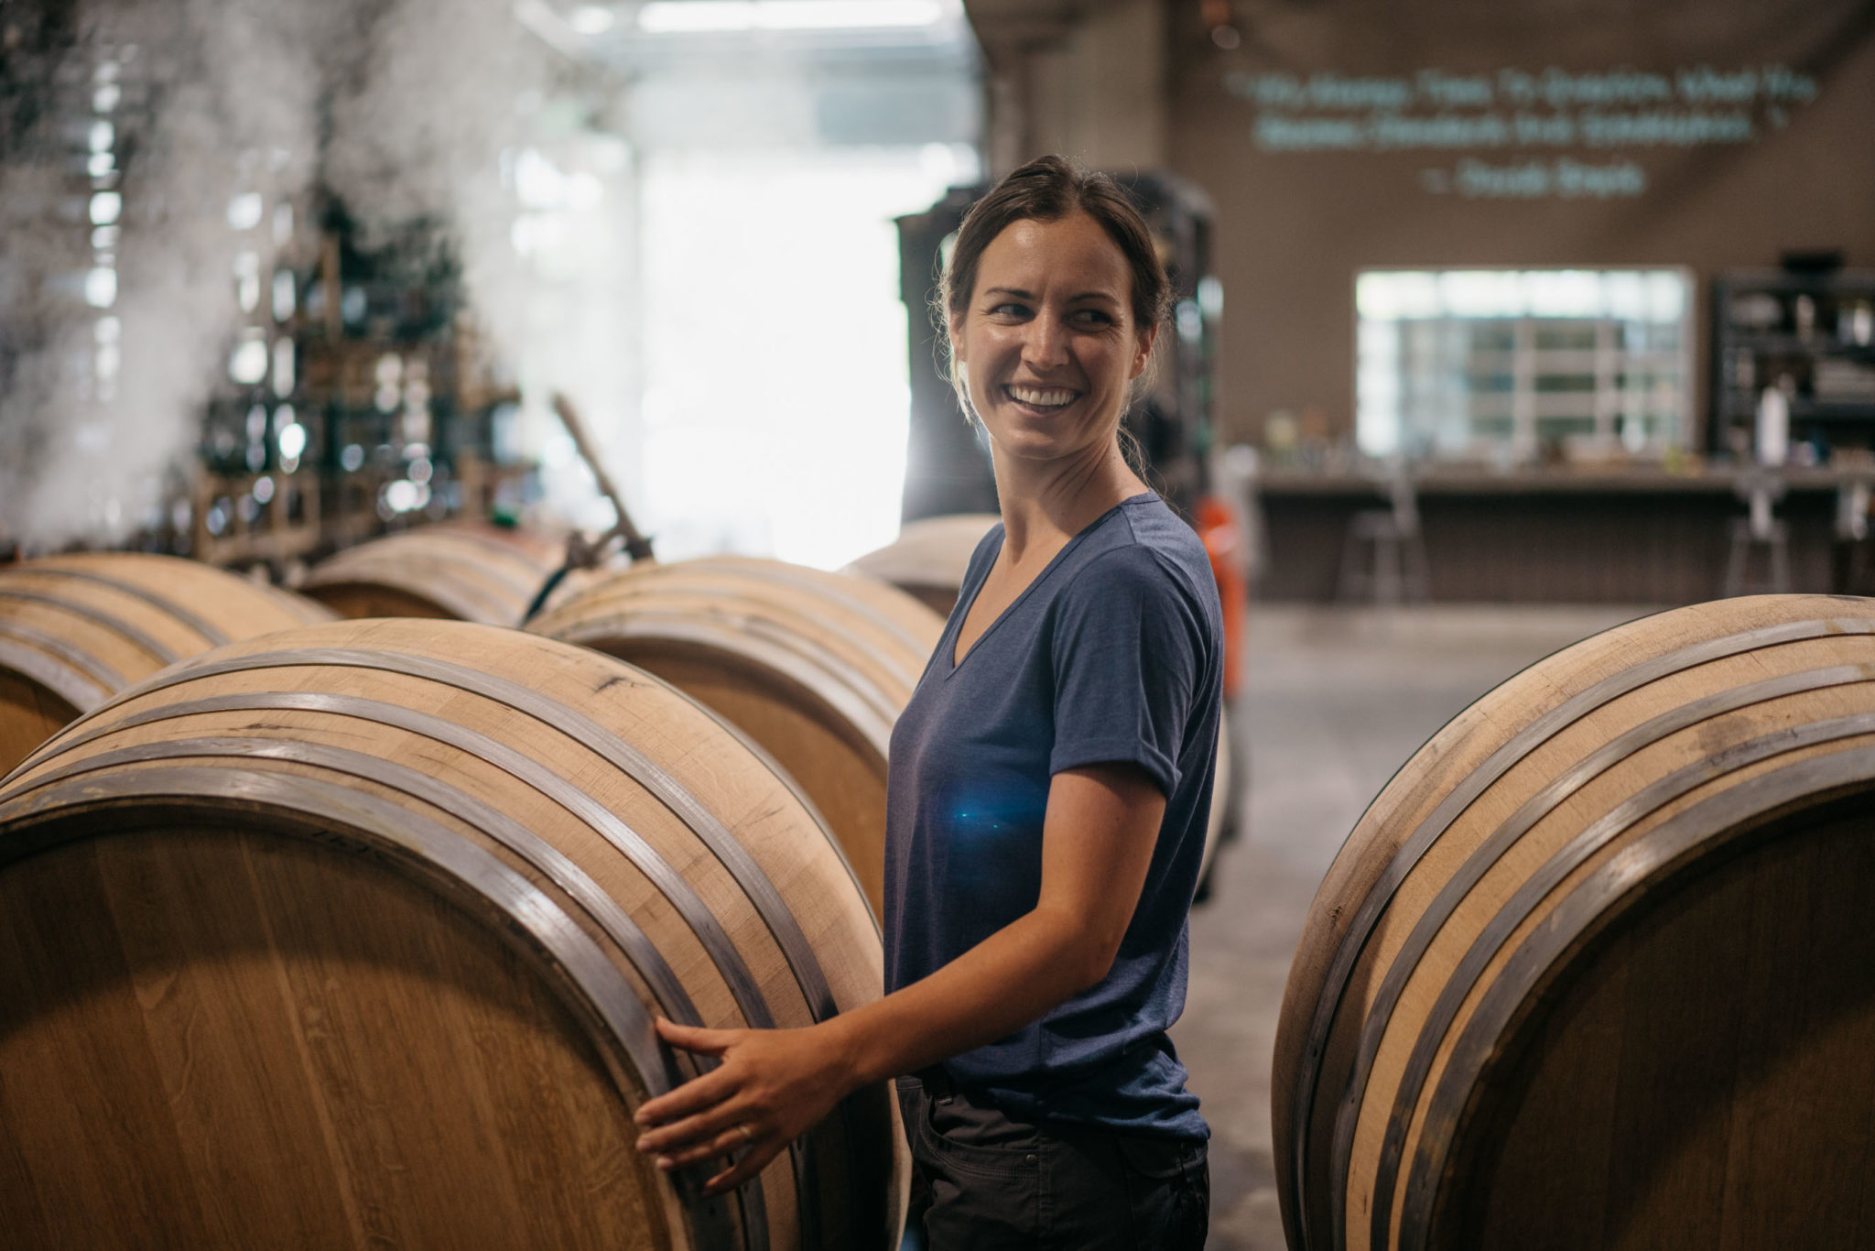
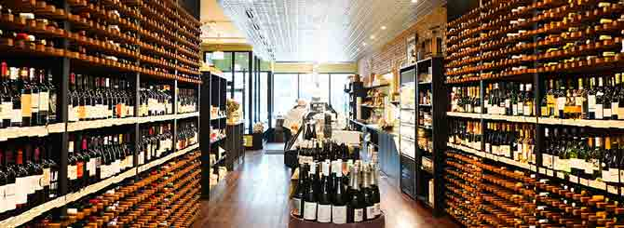
WHO USES IT
WINE MANUFACTURERS WINE INDUSTRIES

Slide 5
ABOUT THE DATASET
All wines are produced in a particular area of Portugal. Data are collected on 12 different properties of the wines one of which is Quality, based on sensory data, and the rest are on chemical properties of the wines including density, acidity, alcohol content etc.
By comparing the best metrics from the model and coming up with a solution for the wine industries:
Some of the use cases for the best-predicted model can be used to:
Address this business problem, we are trying to create a ‘machine learning model that can predict best wine quality through its chemical properties.
The response Quality is assumed to be a continuous variable and is predicted by the independent predictors, all of which are continuous.
Decision tree and Classification of wines based on the chemical properties: Unsupervised analysis.

Slide 6
DATA SOURCE
The dataset extracted are related to wine variants of the Portuguese "Vinho Verde" wine.
Reference: http://www.vinhoverde.pt/en/ The goal is to model wine quality based on physicochemical tests.
These datasets can be viewed as classification or regression tasks. It is a multi-class classification as the quality has more than two classes. The classes are ordered and not balanced (e.g. there are much more normal wines than excellent or poor ones). Outlier detection algorithms could be used to detect the few excellent or poor wines.
Number of Instances: 4898
Number of Attributes: 12 (includes output attribute)
Associated Tasks: Classification
Data Set Characteristics: Multivariate
Date Donated : 2009-10-07

Slide 7
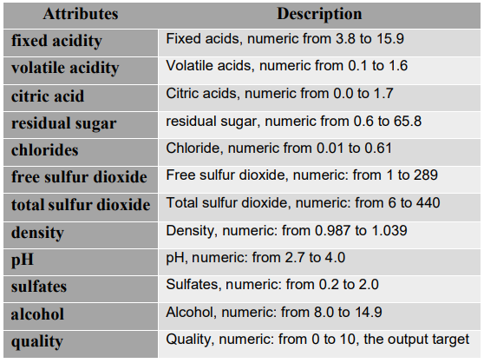
DATASET DESCRIPTION

Slide 8
Slide 1
DATA
PROCESS
MODELLING
METRICS
CONCLUSION
ENHANCEMENTS
LOAD THE DATA TO YOUR IPYNB FILE
PERFORM THE PRE-PROCESSING
BALANCE THE DATA
SPLIT THE DATASET INTO TRAIN AND TEST
SAMPLING THE DATA(OVER SAMPLING)
FIT THE BASE MODEL
SCALING
PERFORM CLASSIFICATION MODELS ON THE DATASET
HPERPARAMETER TUNING
CONFUSION MATRIX
When scaling, group all elements to be scaled. Scale as needed. Use the “Increase Font Size,” “Decrease Font Size” buttons or manually change the font size for the editable text. Delete unwanted elements. Change the line weight of the circles or connecting bars as needed.

Slide 9
MODELS PERFORMED FOR PREDICTION
KNN
DECISION TREE
RANDOM FOREST
ADABOOST
GRADIENT BOOSTING
XGBOOST
LOGISTIC REGRESSION

Slide 10
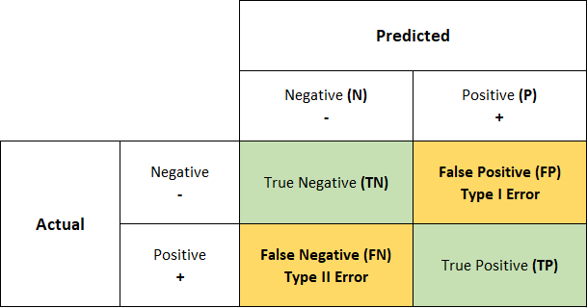
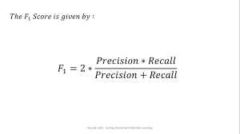
METRICS
FALSE POSITIVE(FP) : Type - I error
The FP infers, low quality wine being sold for High Price.
FALSE NEGATIVE(FN) : Type – II error
The FN infers, high quality wine being sold for Low Price.
We have projected F1 as the primary evaluation metrics for this model through Hyperparameter Tuning to create a balance as per FP and FN.

Slide 11
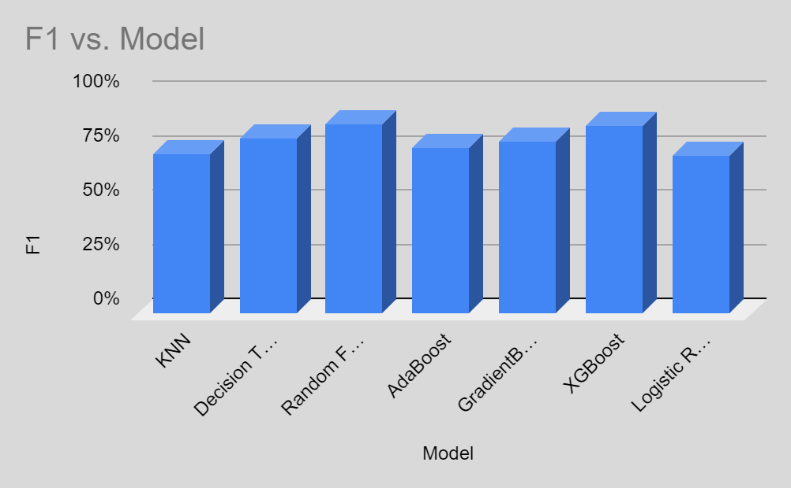
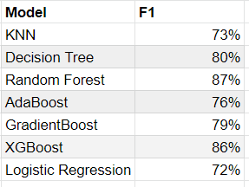
Base Model Results

Slide 12
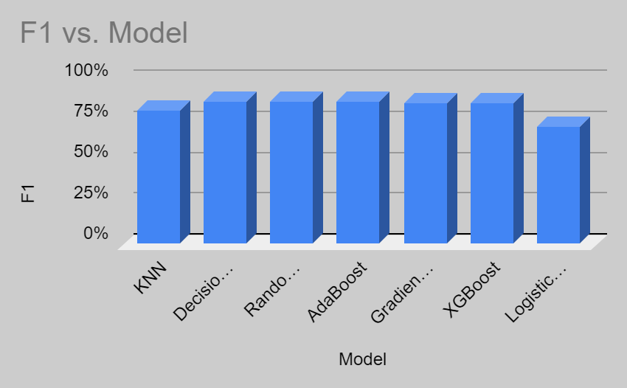
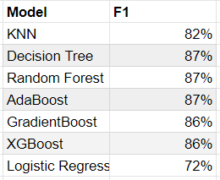
Hyperparameter Tuned Model Results

Slide 13
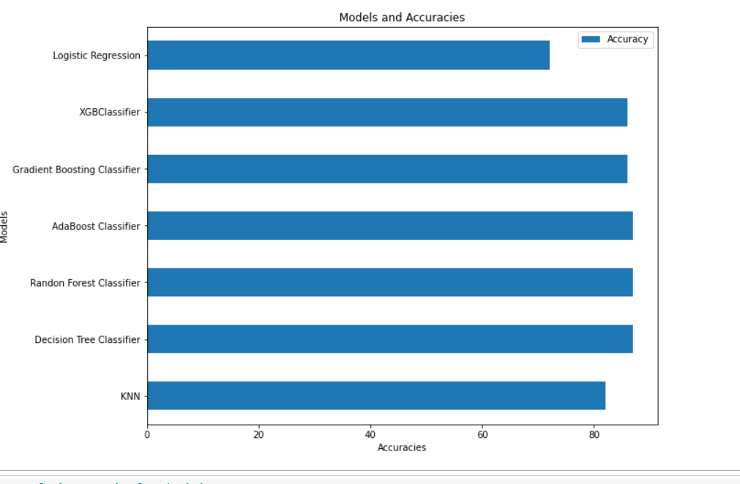
Graphical Representation

Slide 14
Conclusion
The three classification models Decision Tree, Random Forest and AdaBoost predicted the wine quality better than Logistic Regression and other models. This study aims to predict the quality of wine and its combinations through chemical properties even before it is manufactured. This assists the wine manufacturers and wine industries to predict its best quality wine combinators and increase its sales to attain profits. From all the classification models, the above mentioned three classifiers have outperformed.

Slide 15
WHAT CAN BE DONE BEYOND THIS?
NEURAL NETWORKS
ADD More data
FEATURE ENGINEERING FOR BETTER RESULTS

Slide 16
TEAM APEX
VANDANA SIRPA - U87155086
SRI VENKATESH KUMAR SATTU - U01719657
SAI KOTI REDDY SEELAM - U67287368
KEERTHI BAI REDDY - U91888933
SHEERKA SAI NIKHITHA - U19250380
PRASHANTH REDDY THUDI - U52715459

